Slide 1
Verilog Design Pipelined Architecture
EE417 Logic Design Using FPGAs

Slide 2
Pipelined Architecture
The shortest cycle time of the clock of a synchronous sequential machine is a measure of its performance and it is bounded by the propagation delay through the combinational logic of the machine.
The throughput of a synchronous machine is the rate at which data is supplied to or produced by the machine. Throughput is ultimately limited by the path with the largest propagation delay between (1) a primary input and a register, (2) a path between two registers, (3) a path from a register to a primary output, or (4) a path from a primary input to a primary output.

Slide 3
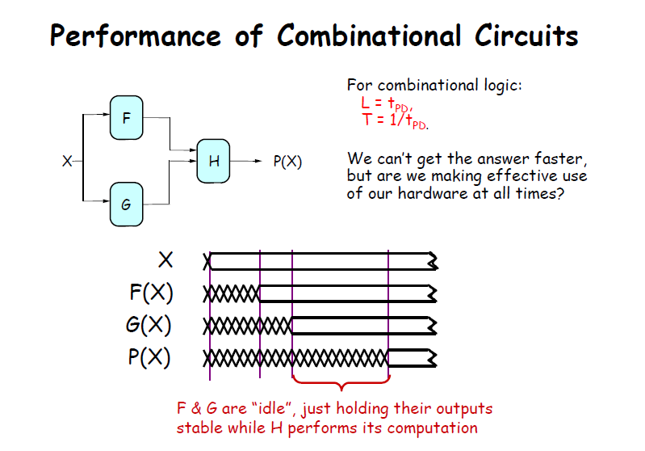
H(X)

Slide 4
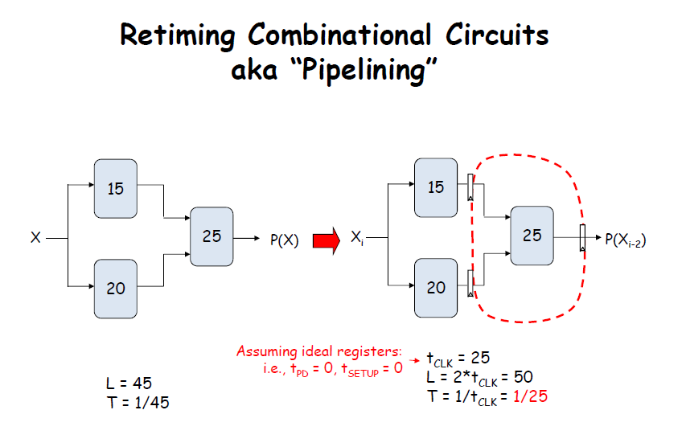

Slide 5
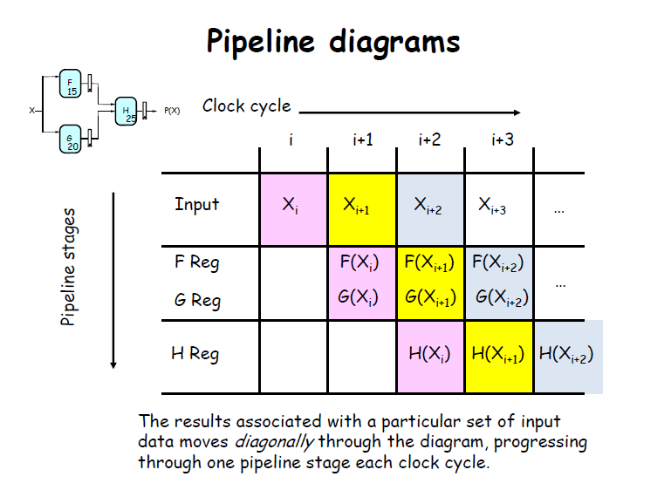

Slide 6
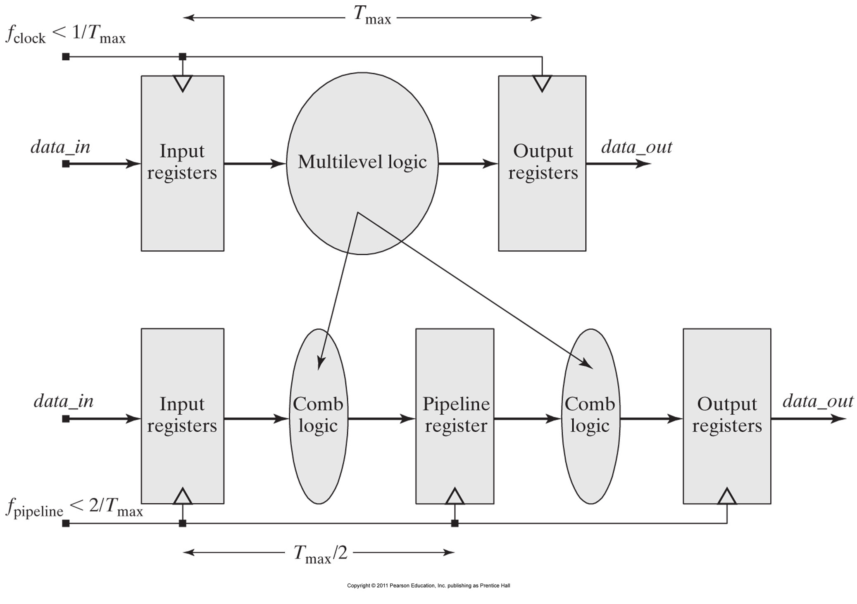
Partitioning a block of multilevel combinational logic and inserting register creates a data pipeline.

Slide 7
PIPLELINE CONVENTIONS:
A K-Stage Pipeline (“K-pipeline”) is a circuit having exactly K registers on every path from an input to an output. A COMBINATIONAL CIRCUIT is thus a 0-stage pipeline. Every pipeline stage has a register on its OUTPUT (not on its input).
The CLOCK common to all registers must have a period sufficient to cover propagation over combinational paths PLUS (input) register HOLD time PLUS (output) register SETUP time.
The LATENCY of a K-pipeline is K times the period of the clock common to all registers.
The THROUGHPUT of a K-pipeline is the frequency of the clock.

Slide 8
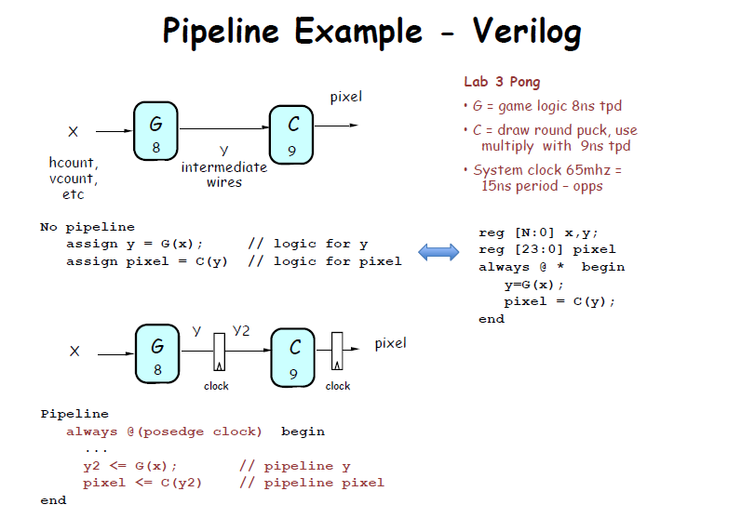

Slide 9
Pipelining:
Pipelining introduces additional area in the physical layout of an ASIC, and require additional routing of clock resources. FPGAs are register-rich and readily support pipelined structures.
The delay of the slowest combinational logic stage determines the performance of the pipelined circuit and the speed of the common clock.
Pipelining shortens the clock cycle and increases the throughput but introduces input-output latency.
Pipelining trades spatial complexity for temporal complexity by computing smaller functions in less time. It distributes across multiple clock cycles the breadth of logic that would be required to implement the complete function in one clock cycle.

Slide 10
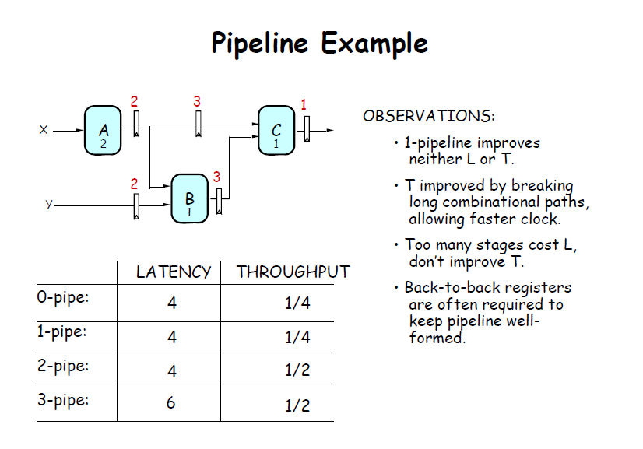

Slide 11
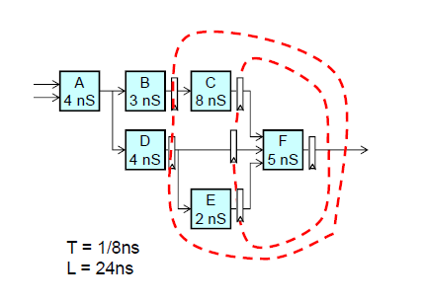
STRATEGY:
Focus your attention on placing pipelining registers around the slowest circuit
elements (BOTTLENECKS).
The partition of a data-path must maintain coherency of the data.
A data-path traced from any primary input to any primary output must pass through the same number of pipeline registers.
Pipeline cut-sets specify the locus for pipeline registers.

Slide 12
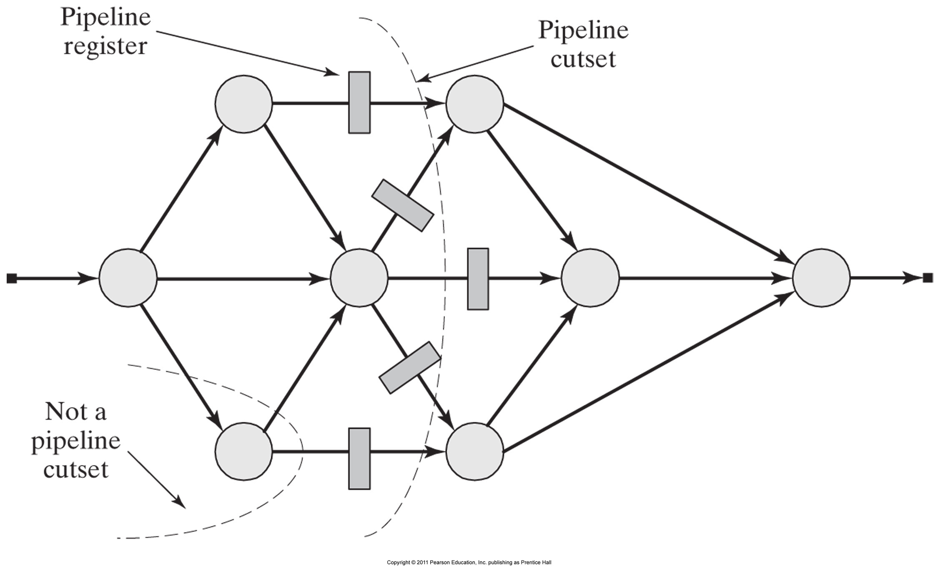
Pipeline cutsets specify the locus for pipeline registers.

Slide 13
A pipeline cut-set is a minimum set of edges that, if removed from the graph, partitions it into two subgraphs such that there is no path between an input node and an output node.

Slide 14
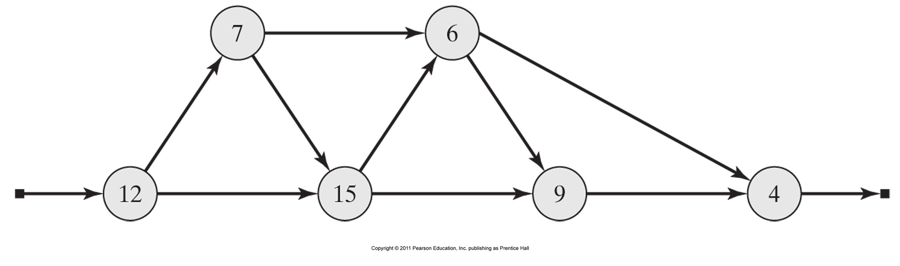
Example:
The nodes of the Data Flow Graph (DFG) shown have been annotated with propagation delays. Find the optimal placement of pipeline registers in the circuit.
Calculate the throughput and latency for each case.

Slide 15
Example: Pipelined Adder
Digital systems that operate on arrays of data typically contain a large number of adders in an array structure. The processing speed in these applications is usually critical and may warrant pipelining.
A 16-bit adder is formed by chaining two 8-bit adders in a serial connection. If each 8-bit adder has a throughput delay of 100ns the worst case delay of the configuration would be 200ns. In a synchronous environment, this structure is organized to have all operations occur in the same clock cycle. An alternative structure can be pipelined to operate at a higher throughput by distributing the processing over multiple clock cycles.
Design your adder (with two stages), show your register locations (cutsets) and write the Verilog code.

Slide 16
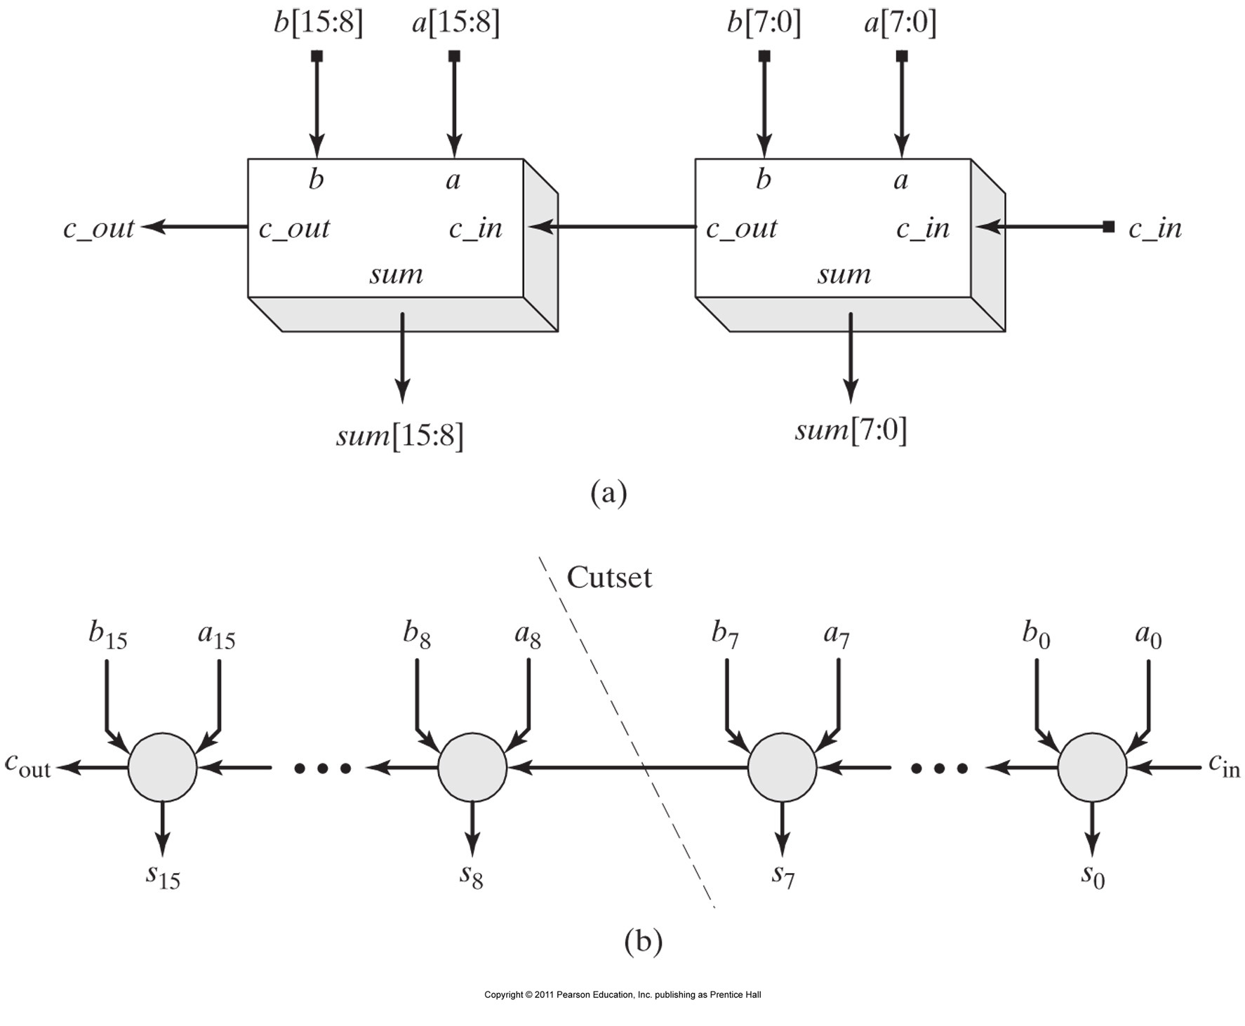
A pipelined 16-bit adder:
(a) serial connection of two 8-bit adders to form a 16-bit adder, (b) DFGs before pipelining

Slide 17
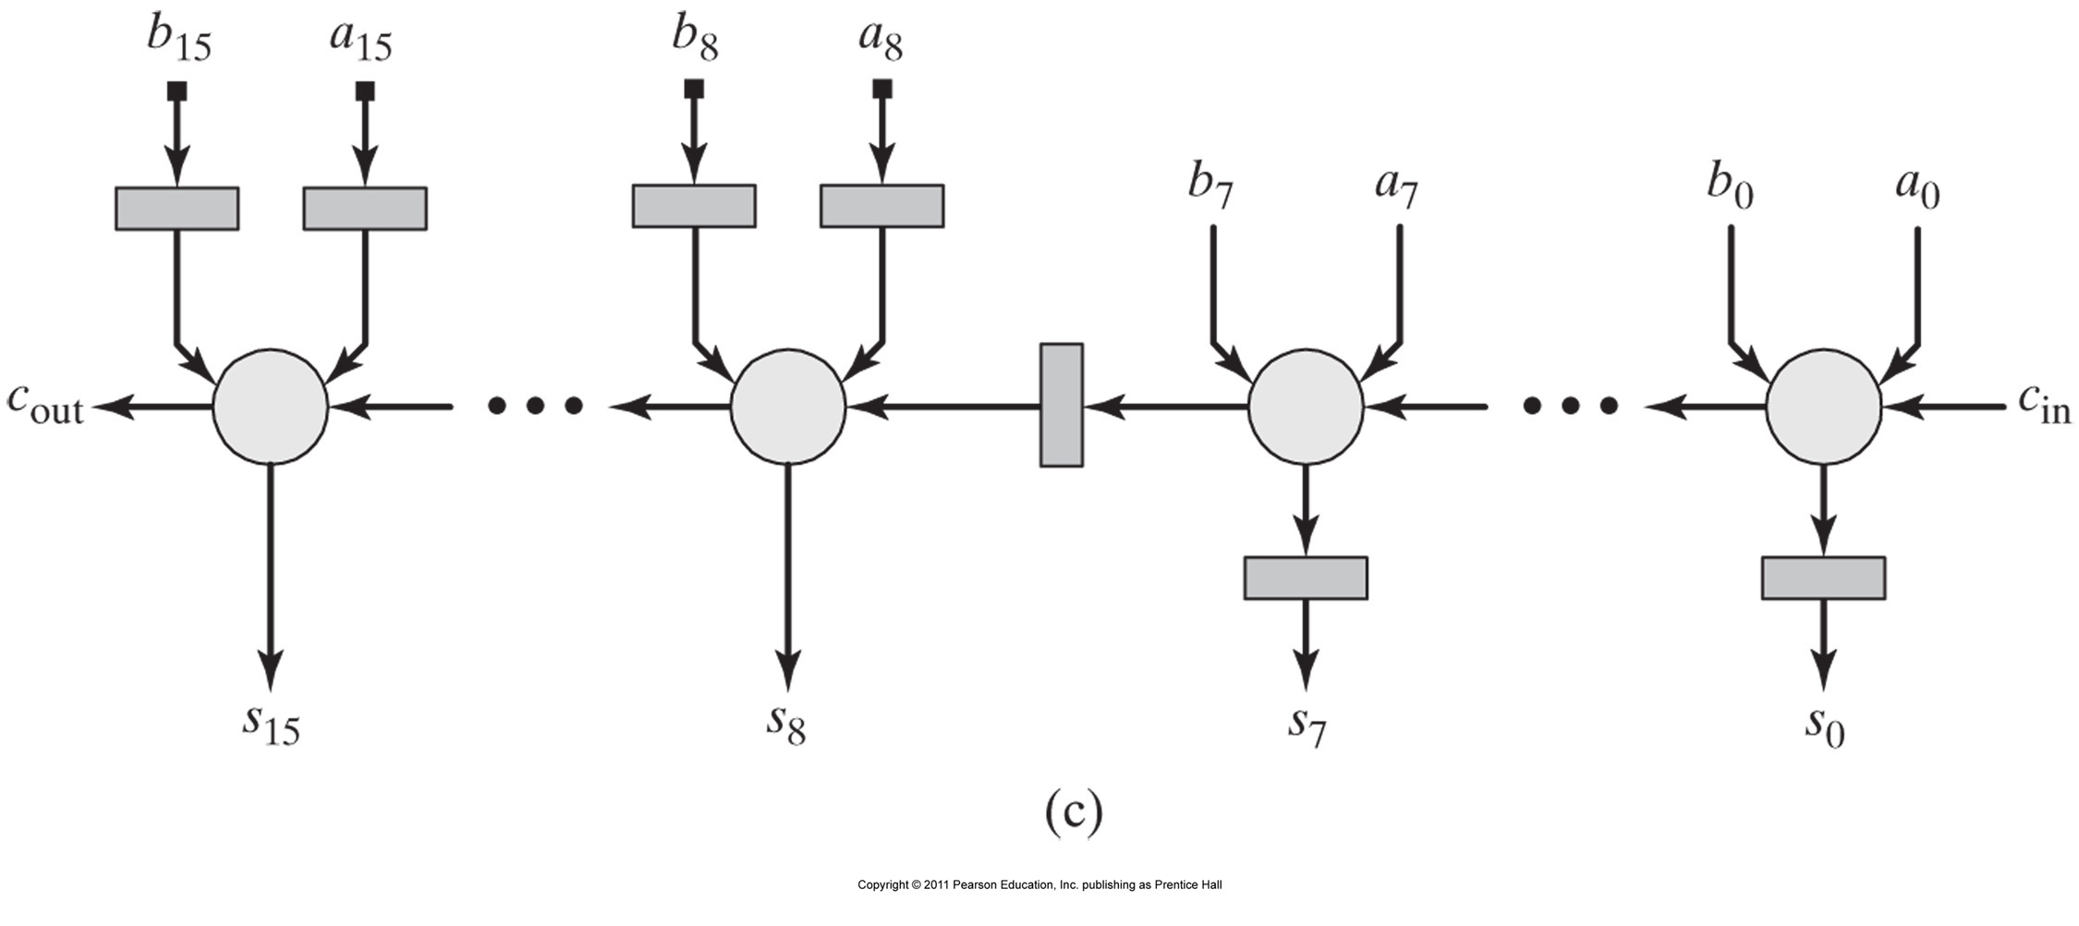
A pipelined 16-bit adder: (c) after pipelining for balanced stage delays.

Slide 18
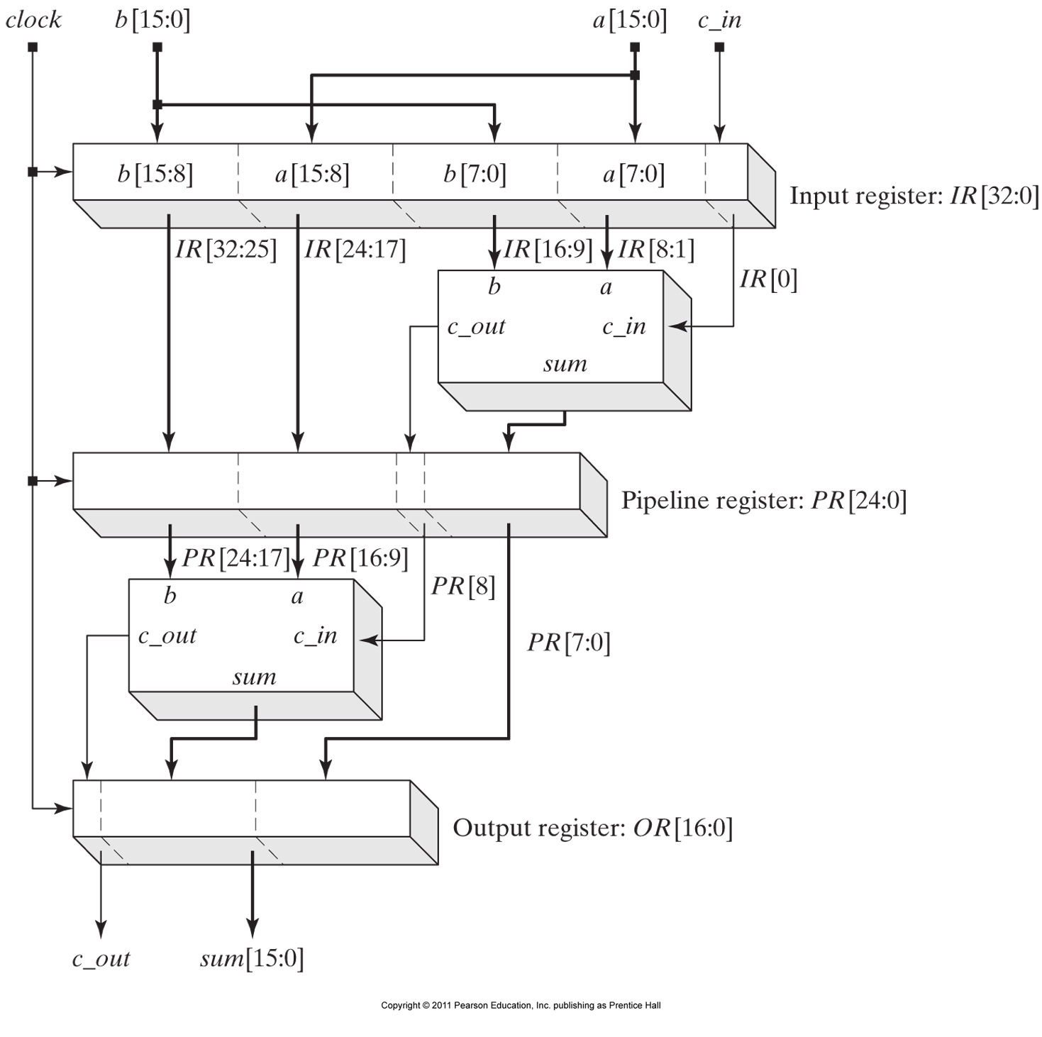
Pipelined 16-bit adder structure

Slide 19
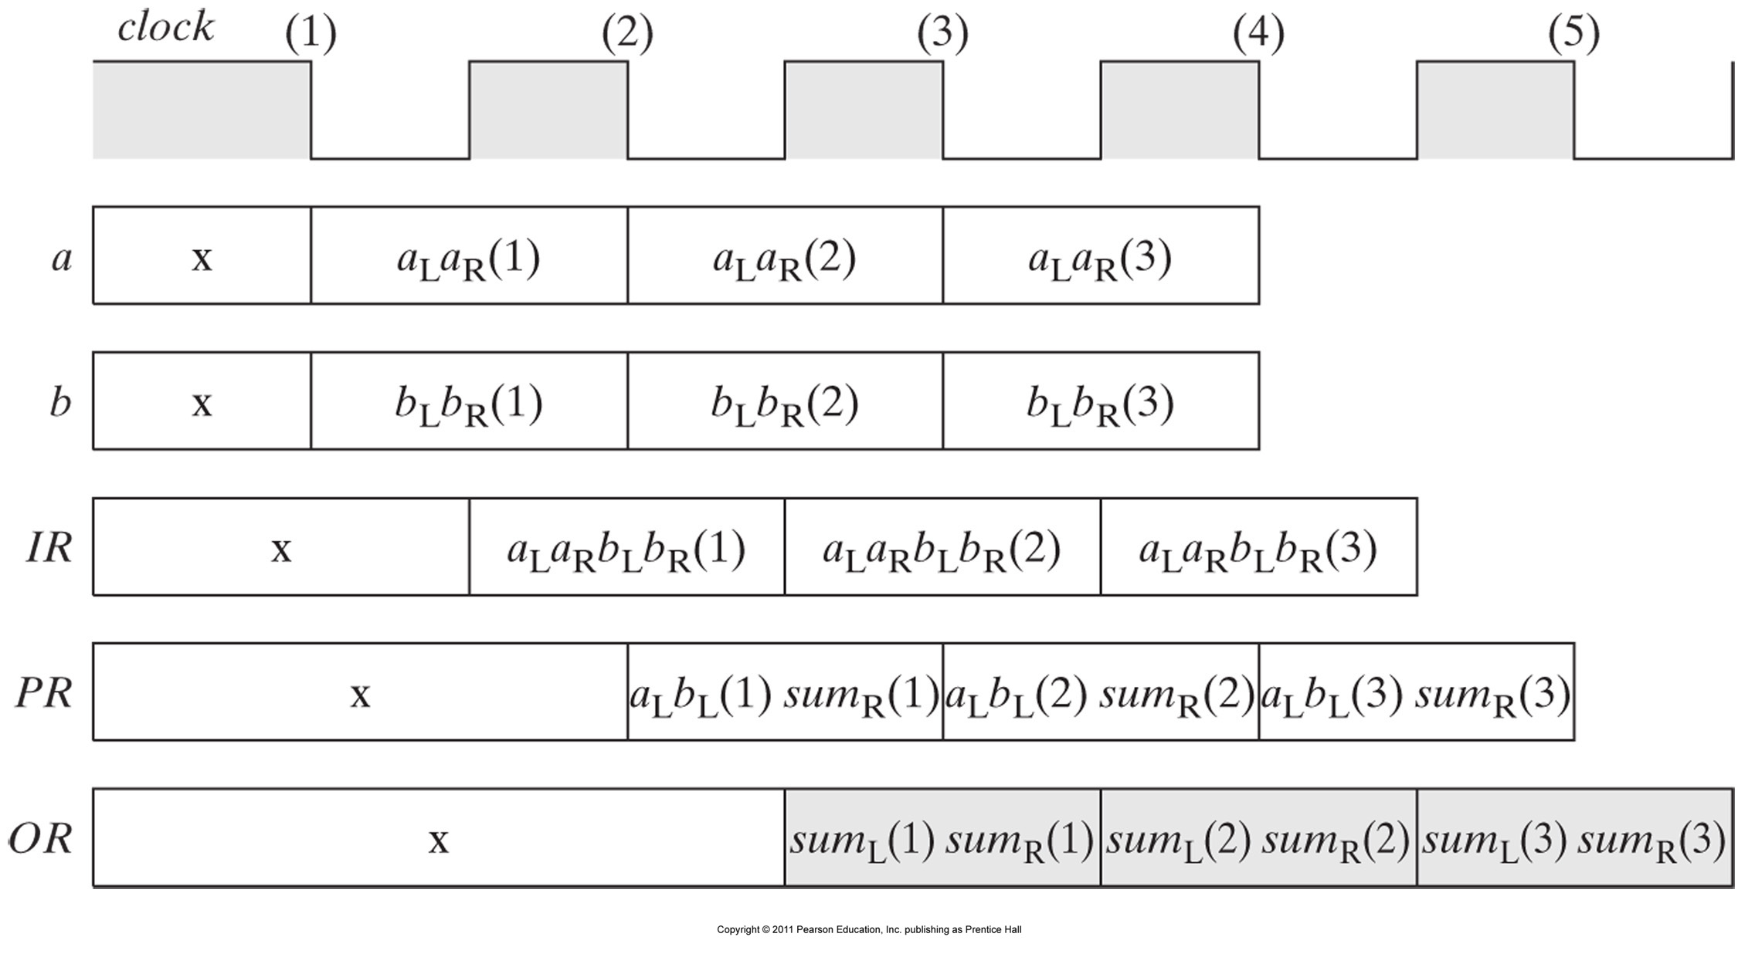

Slide 20

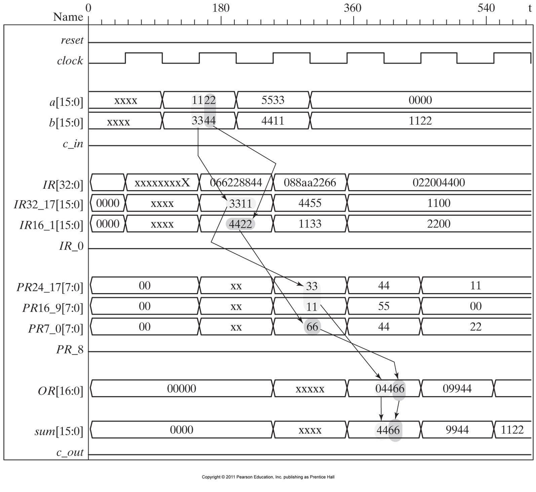
Simulation results of the data flow.
The Verilog code mainly uses
non-blocking procedural assignments

